Slide 1
Regression
Aubrey Hormel and Nick Delamora

Slide 2
Outline
Introduction
Use Cases
MLlib Regression Models
Evaluators and Model Tuning
Metrics
Conclusion

Slide 3
Introduction
A logical extension of classification:
Yields a continuous variable from a set of features
Optimize some metric of error
Notes:
Regression give a real number from features -- which are themselves numbers
Error metric between predicted and true values (as opposed to an accuracy rate with classification)

Slide 4
Use Cases
Movie Viewership
Given info for a certain movie, such as how many people have watched/shared the trailer, predict how many people are likely to watch it
Company Revenue
Given growth trajectory, the market, and the time of year, predict a company’s future revenue
Crop Yield
Given info about the area in which a crop is grown and a recent history of weather conditions, predict total crop yield for a certain plot of land

Slide 5
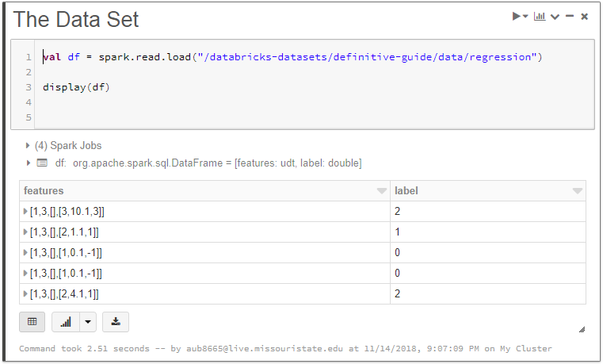

Slide 6
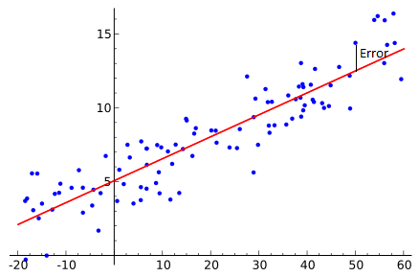
Linear Regression
Overview
import org.apache.spark.ml.regression.LinearRegression
Assumes that a linear combination of your input features yields a prediction within a Gaussian amount of error of the true value.

Slide 7
Linear Regression
Overview
import org.apache.spark.ml.regression.LinearRegression
Assumes that a linear combination of your input features yields a prediction within a Gaussian amount of error of the true value.
Does not always hold true, but DOES provide a simple model that is easy to interpret and hard to overfit.

Slide 8
Linear Regression
Hyperparameters
Params | Values | Description
family | Multinomial or binary | Multiclass vs binary classification
elasticNetParam | Floating point ∈ [0, 1] | Specifies mix between L1, L2 regularization: Mix = r*L1 + (1-r)*L2
fitIntercept | Boolean | If true- fits the intercept of response variable
regParam | r >= 0 | How much weight to five reg term
standardization | Boolean | If true- standardize inputs

Slide 9
Linear Regression
Training Parameters
Params | Values | Description
maxIter | Default = 100 | Upper bound on number passes
tol | Default = 10^-6 | Allows algorithm to stop before maxIter
weightCol | Default = None (weight column name) | Used to weight certain rows more than others **
regParam | r >= 0 | How much weight to five reg term
standardization | Binary | If true- standardize inputs

Slide 10
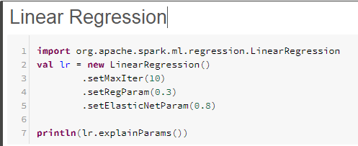
Linear Regression
Example

Slide 11
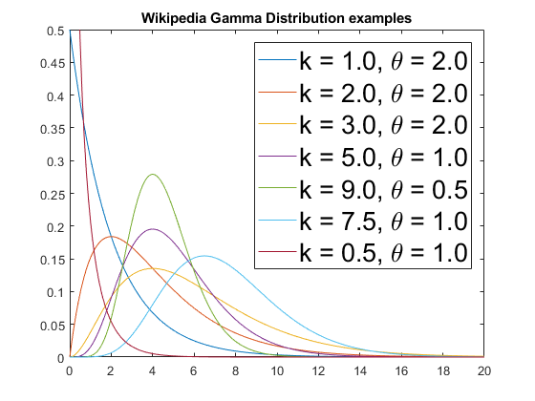
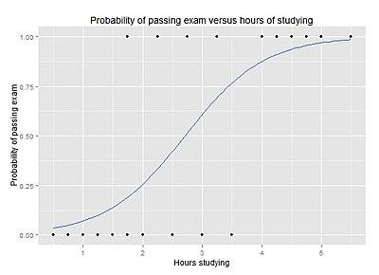
Generalized Linear Regression
Overview
import org.apache.spark.ml.regression.GeneralizedLinearRegression
A larger, more abstract family of algorithms -- simple linear regression included

Slide 12
Generalized Linear Regression
Overview
import org.apache.spark.ml.regression.GeneralizedLinearRegression
A larger, more abstract family of algorithms -- simple linear regression included
Spark has different implementations for simple vs the rest of generalized:
Simple LR model optimized for very large sets of features
Generalized LR supports more algorithms (e.g. error distr & link function)

Slide 13
Generalized Linear Regression
Overview
More control over what kind of regression model you use.
For instance you may select an expected noise distribution for a variety of families:
Gaussian (linear)
Binomial (logistic)
Poisson (poisson)

Slide 14
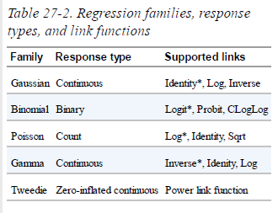
Generalized Linear Regression
Overview
Can also set a link function which specifies a relationship between linear predictor and expected value of response variable
η or g(μ)
η = g(E(Y_{i} ))
Where E(Y_{i} ) is expected value of response variable for some X_{i}
Asterisks represent the typical link function for each error distr family

Slide 15
Generalized Linear Regression
Hyperparameters
Params | Values | Description
family | Poisson, binomial, gamma, Gaussian, tweedie | Describes error distribution to be used
link | Default = identify *Options vary based on error distr family | Name of function which gives relationship between linear predictor and and the expected value of the response variable
solver | irls | Solver algorithm used for optimization
variancePower | x ∈ 0, [1, inf) | Power in variance func of Tweedie distr
linkPower | integer | Index in power link function for Tweedie Family

Slide 16
Generalized Linear Regression
Parameters
Training parameters are the same as Linear and Logistic regression
One additional Prediction Parameter:
linkPredictionCol -- the name of a column which will hold output of the link function for each prediction

Slide 17
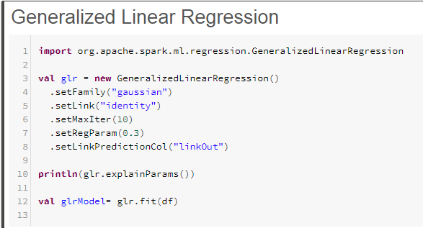
Generalized Linear Regression
Example

Slide 18
Simple & Gen. Linear Regression
Training Summary
Training summary provided by Spark can help us decide if our model is a good fit for the data (for both simple and generalized linear regression).
Includes many metrics for analysis:
R squared
Residuals
Objective History
Full list- org.apache.spark.ml.regression.LinearRegressionSummary, or inspect summary object.

Slide 19
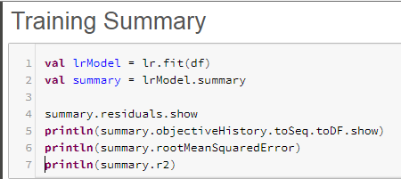
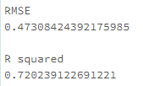
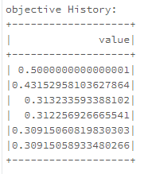
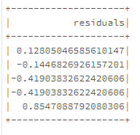
Simple & Gen. Linear Regression
Training Summary

Slide 20
Decision Trees
Overview
import org.apache.spark.ml.regression.DecisionTreeRegressor
Similar to DT for classification -- output a single number at a leaf node as opposed to a label.
Creates a tree to predict numerical outputs
Useful -- can predict nonlinear functions
Significant risk of overfitting

Slide 21
Decision Trees
Hyperparameters
Params | Value | Description
impurity | variance | The metric for whether the model should split at a particular leaf node
maxDepth | Default = 5 | Can specify maxDepth to avoid overfitting
maxBins | Default = 32 | How many bins to be created from continuous features
minInfoGain | Default = 0 | Min info gain that can be used for a split
minInstancePerNode | Default = 1 | Min number samples that end up in a given leaf node

Slide 22
Decision Trees
Training Parameters
checkpointInterval
A way to save the model’s work while training so that if nodes in the cluster crash, you don’t lose your work.
If set to 10, means the model will get checkpointed every 10 iterations. Set this to -1 to turn off checkpointing. This parameter needs to be set together with a checkpointDir (a directory to checkpoint to) and useNodeIdCache=true.
HiHellerrrrrr

Slide 23
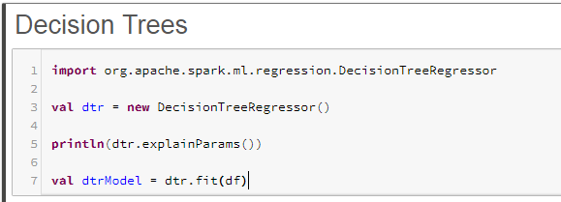
Decision Trees
Example

Slide 24
Random Forest
Overview
import org.apache.spark.ml.regression.RandomForestRegressor
An extension of Decision Trees that makes a prediction using an additive model by combining decisions from a sequence of base models (an average)

Slide 25
Random Forest
Overview
import org.apache.spark.ml.regression.RandomForestRegressor
An extension of Decision Trees that makes a prediction using an additive model by combining decisions from a sequence of base models (an average).
This broad technique of using multiple models to obtain better predictive performance is called model ensembling
Very good at handling tabular data with numerical features, or categorical features with fewer than hundreds of categories.
Unlike linear models, random forests are able to capture non-linear interaction between the features and the target.

Slide 26
Gradient-Boosted Trees
Overview
import org.apache.spark.ml.regression.GBTRegressor
The gradient-boosted trees technique makes a weighted prediction by computing a sequence of very simple trees that each are formed from the residuals of the preceding tree

Slide 27
Gradient-Boosted Trees
Overview
import org.apache.spark.ml.regression.GBTRegressor
The gradient-boosted trees technique makes a weighted prediction by computing a sequence of very simple trees that each are formed from the residuals of the preceding tree
At each step:
a simple (best) partitioning of the data is determined,
the deviations of the observed values from the respective means (residuals for each partition) are computed
The next 3-node tree will then be fitted to those residuals, to find another partition that will further reduce the residual (error) variance for the data

Slide 28
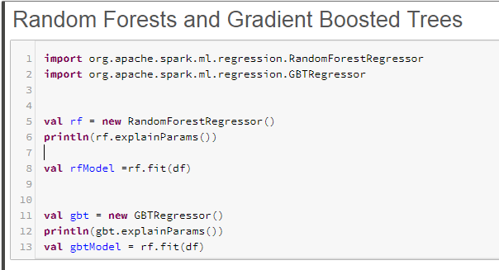
Random Forests and GBTs Example

Slide 29
Random Forests & GBTs
Hyperparameters
Model | Parameter | Value | Description
Random Forest | numTrees | Int | Total number trees to train
 | featureSubsetStrategy | auto, all, sqrt, log2, n | How many features should be considered for splits
Gradient-Boosted Trees | lossType | logistic | The loss func for gbt to minimize
 | maxIter | Default = 100 | Total num iterations before stopping
 | stepSize | Default = 0.1 x ∈[0,1] | The learning rate; larger step size => larger jump between iterations

Slide 30
Advanced Methods - Survival Regression
Overview
import org.apache.spark.ml.regression.AFTSurvivalRegression
Survival analysis - understanding the survival of individuals

Slide 31
Advanced Methods - Survival Regression
Overview
import org.apache.spark.ml.regression.AFTSurvivalRegression
Survival analysis - understanding the survival of individuals
Survival Regression (Accelerated Failure Time) model - used by spark and stores the log of the survival time as oppose to the exact survival time
This variation was chosen since it is scalable to large datasets. Each row contributes to the model independently and therefore can be parallelized

Slide 32
Advanced Methods - Survival Regression
Overview
import org.apache.spark.ml.regression.AFTSurvivalRegression
Survival analysis - understanding the survival of individuals
Survival Regression (Accelerated Failure Time) model - used by spark and stores the log of the survival time as oppose to the exact survival time
This variation was chosen since it is scalable to large datasets. Each row contributes to the model independently and therefore can be parallelized
Instantiated with a parameter that is a set of Quantile Probabilities
quantile - each of any set of values of a variate that divide a frequency distribution into equal groups, each containing the same fraction of the total population

Slide 33
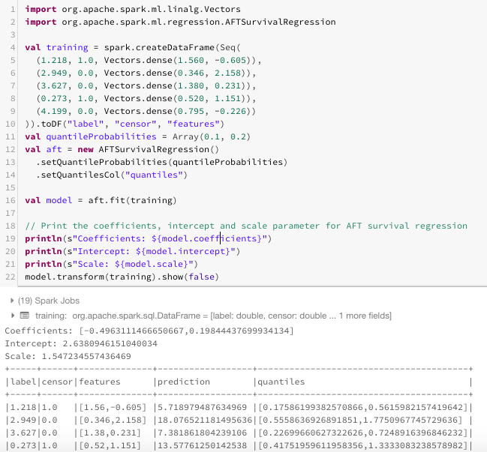
Advanced Methods - Survival Regression
Example

Slide 34
Advanced Methods - Isotonic Regression
Overview
import org.apache.spark.ml.regression.IsotonicRegression
Isotonic Regression
Specifies a piecewise linear function that is monotonically increasing, and cannot decrease (works best for data that is going up and to the right)

Slide 35
Advanced Methods - Isotonic Regression
Overview
import org.apache.spark.ml.regression.IsotonicRegression
Isotonic Regression
Specifies a piecewise linear function that is monotonically increasing, and cannot decrease (works best for data that is going up and to the right)
Gets a better fit than simple linear regression on this type of data due to it’s flexibility since it is defined piecewise
Includes information on the boundaries and predictions of the model

Slide 36
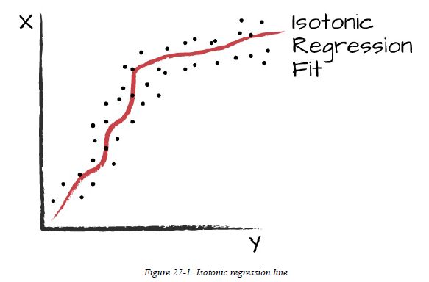
Advanced Methods - Isotonic Regression
Overview

Slide 37
Model Scalability
Model | Number Features | Training Examples
Linear Regression | 1 to 10 million | No limit
Generalized Linear Regression | 4096 | No limit
Isotonic Regression | N/A | Millions
Decision Trees | 1,000s | No limit
Random Forest | 10,000s | No limit
Gradient-Boosted Trees | 1000s | No limit
Survival Regression | 1 to 10 million | No limit

Slide 38
Evaluators and Automating Model Tuning Overview
import org.apache.spark.ml.evaluation.RegressionEvaluator
Same core model tuning as classification
Steps:
Specify an Evaluator
Pick a metric to optimize
Train pipeline to perform parameter tuning

Slide 39
Evaluators and Automating Model Tuning Overview
Step 1 Build the RegressionEvaluator object and specify two columns
The two required columns are (prediction, label)
Step 2 There are four supported metrics to optimize for:
Root Mean Squared Error, Mean Squared Error, R2, and Mean Absolute Error
Step 3 Create a Pipeline, ParamGridBuilder, then pass those two and the RegressionEvaluator to build a CrossValidator object

Slide 40
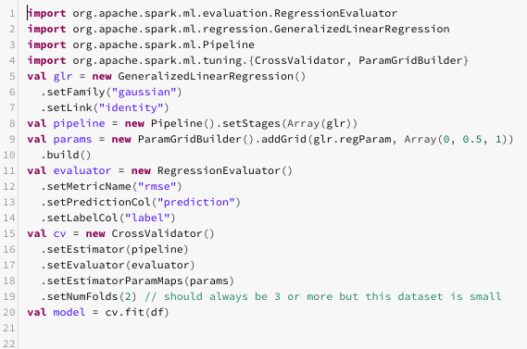
Evaluators and Automating Model Tuning Example

Slide 41
Metrics Overview
org.apache.spark.mllib.evaluation.RegressionMetrics
First map the model into this format: (prediction, label) pairs
Then create a RegressionMetrics object with that formatted model as a parameter
The object contains methods that will return statistical values of the data set including
Mean Squared Error
Root Mean Squared Error
R Squared
Mean Absolute Error
Explained Variance

Slide 42
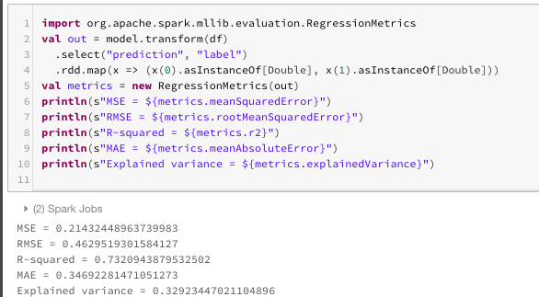
Metrics Example

Slide 43
Conclusion
Regression can be thought of as an abstraction of classification -- where we wish our model to predict a continuous variable according to a linear combination of input features (the coefficients of which are chosen by regression to minimize error).

Slide 44
Conclusion
Simple and Generalized Linear Regression are useful when we have some idea of data distribution, but are interpretable and hard to overfit
Trees are useful in predicting nonlinear data, but at a higher risk of overfitting
Spark also includes more context-specific regression models, such as Survival & Isotonic Regression

Slide 45
Conclusion
Similar to classification, to optimize our model we can:
Specify an evaluator (RegressionEvaluator)
choose a metric to optimize for (several available via RegressionMetrics)
train a pipeline to tune parameters for us

Slide 46
References
https://turi.com/learn/userguide/supervised-learning/random_forest_regression.html
http://spark.apache.org/docs/latest/ml-classification-regression.html#isotonic-regression
http://enhancedatascience.com/2017/07/04/machine-learning-explained-regularization/
https://onlinecourses.science.psu.edu/stat504/node/216/

